Slide 1
Computer Security and Protection
CS 3100: Supplemental Notes for Chapters 14-15

Slide 2
Computer and Network Security Requirements
Confidentiality
  Requires information in a computer system only be accessible for reading by authorized parties
Integrity
  Assets can be modified by authorized parties only
Availability
  Assets be available to authorized parties
Authenticity
  Requires that a computer system be able to verify the identity of a user

Slide 3
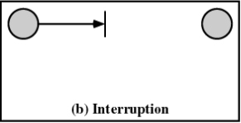
Types of Threats
Interruption
  An asset of the system is destroyed or becomes unavailable or unusable
  Attack on availability
  Examples: Destruction of hardware,
  Cutting of a communication line,
  Disabling the file management system

Slide 4
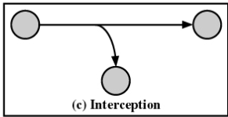
Types of Threats
Interception
  An unauthorized party gains access to an asset
  Attack on confidentiality
  Examples: Wiretapping to capture data in a network, Illicit copying of files or programs

Slide 5
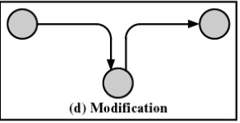
Types of Threats
Modification
  An unauthorized party not only gains access but tampers with an asset
  Attack on integrity
  Examples: Changing values in a data file, Altering a program so that it performs differently, Modifying the content of messages being transmitted in a network

Slide 6
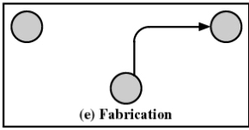
Types of Threats
Fabrication
  An unauthorized party inserts counterfeit objects into the system
  Attack on authenticity
  Examples: Insertion of spurious messages in a network, Addition of records to a file

Slide 7
Computer System Assets
Hardware
  Threats include accidental and deliberate damage
Software
  Threats include deletion, alteration, damage
  Backups of the most recent versions can maintain high availability

Slide 8
Computer System Assets
Data
  Involves files
  Security concerns include availability, secrecy, and integrity
  Statistical analysis can lead to determination of individual information which threatens privacy

Slide 9
Computer System Assets
Communication Lines and Networks – Passive Attacks
  Release of message contents from a telephone conversion, an electronic mail message, and a transferred file are subject to these threats
  Traffic analysis
    Even with Encryption in place, an opponent may still be able to observe patterns, frequency, and lengths of messages.

Slide 10
Computer System Assets
Communication Lines and Networks – Active Attacks
  Masquerade takes place when one entity pretends to be a different entity
  Replay involves the passive capture of a data unit and its subsequent retransmission to produce an unauthorized effect
  Modification of messages means that some portion of a legitimate message is altered, or that messages are delayed or reordered, to produce an unauthorized effect

Slide 11
Protection
Share all or share nothing
  Owner of an object declares it public or private
Share via access limitation
  Operating system checks the permissibility of each access by a specific user to a specific object
  Operating system acts as the guard

Slide 12
Protection
Share via dynamic capabilities
  Dynamic creation of sharing rights for objects
Limit use of an object
  Limit not only access to an object but also the use to which that object may be put
  Example: a user may be able to derive statistical summaries but not to determine specific data values

Slide 13
Access Matrix
Subject
  An entity capable of accessing objects
Object
  Anything to which access is controlled
Access rights
  The way in which an object is accessed by a subject

Slide 14
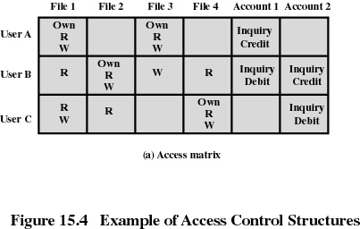
Access Matrix

Slide 15
Access Control List
Matrix decomposed by columns
For each object, an access control list gives users and their permitted access rights

Slide 16
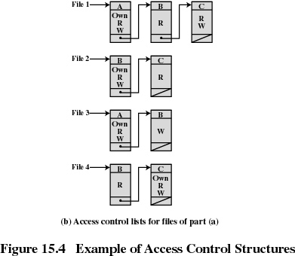
Access Control List

Slide 17
Capability Tickets
Decomposition of access matrix by rows
Specifies authorized object and operations for a user

Slide 18
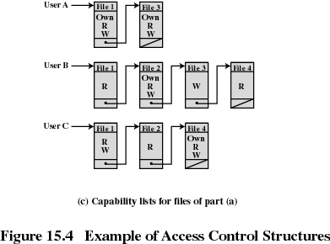
Capability Tickets

Slide 19
Intrusion Techniques
Objective of intruder is the gain access to the system or to increase the range of privileges accessible on a system
Protected information that an intruder acquires is a password
The password may be protected by One-way encryption or Access Control.

Slide 20
Intrusion Detection
Inevitably, the best prevention system will fail. Therefore, a second line of defense is DETECTION….

Slide 21
Intrusion Detection
Statistical anomaly detection
  Collect data related to the behavior of legitimate users over a period of time
  Statistical tests are used to determine if the behavior is not legitimate behavior
    Threshold and Profile Based
Rule-based detection
  Rules are developed to detect deviation form previous usage pattern
  Expert system searches for suspicious behavior

Slide 22
Intrusion Detection
Audit record
  Native audit records
    All operating systems include accounting software that collects information on user activity
  Detection-specific audit records
    Collection facility can be implemented that generates audit records containing only that information required by the intrusion detection system

Slide 23
Intrusions via Malicious Software
Those that need a host program
  Fragments of programs that cannot exist independently of some application program, utility, or system program
Independent
  Self-contained programs that can be scheduled and run by the operating system

Slide 24
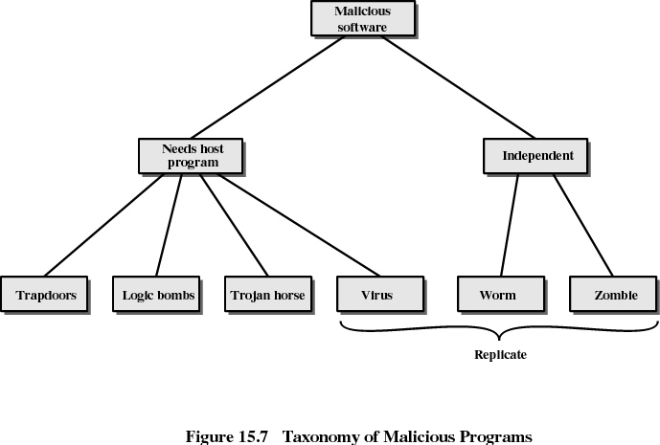

Slide 25
Viruses
Program that can “infect” other programs by modifying them
  Modification includes copy of virus program itself
  The infected program can infect other programs

Slide 26
Virus Stages
Dormant phase
  Virus is idle
Propagation phase
  Virus places an identical copy of itself into other programs or into certain system areas on the disk
Triggering phase
  Virus is activated to perform the function for which it was intended
  Caused by a variety of system events
Execution phase
  Function is performed

Slide 27
Types of Viruses
Parasitic
  Attaches itself to executable files and replicates
  When the infected program is executed, it looks for other executables to infect
Memory-resident
  Lodges in main memory as part of a resident system program
  Once in memory, it infects every program that executes

Slide 28
Types of Viruses (continued)
Boot sector
  Infects boot record
  Spreads when system is booted from the disk containing the virus
Stealth
  Designed to hide itself form detection by antivirus software
  May use compression
  May use disk I/O routines

Slide 29
Types of Viruses
Polymorphic
  Mutates with every infection, making detection by the “signature” of the virus impossible
  Mutation engine creates a random encryption key to encrypt the remainder of the virus
    The key is stored with the virus

Slide 30
Macro Viruses
Platform independent
  Most infect Microsoft Word, Outlook
Infect document, not executable portions of code
Easily spread

Slide 31
Macro Viruses
A macro is an executable program embedded in a word processing document or other type of file
Autoexecuting macros in Word
  Autoexecute
    Executes when Word is started
  Automacro
    Executes when defined event occurs such as opening or closing a document
  Command macro
    Executed when user invokes a command (e.g., File Save)

Slide 32
E-mail Virus
Activated when recipient opens the e-mail attachment
Uses Visual Basic scripting language
Propagates itself to all of the e-mail addresses known to the infected host

Slide 33
Worms
Use network connections to spread from system to system
Electronic mail facility
  A worm mails a copy of itself to other systems
Remote execution capability
  A worm executes a copy of itself on another system
Remote log-in capability
  A worm logs on to a remote system as a user and then uses commands to copy itself from one system to the other

Slide 34
Zombie
Program that secretly takes over another Internet-attached computer
It uses that computer to launch attacks that are difficult to trace to the zombie’s creator

Slide 35
Trapdoor
Entry point into a program that allows someone who is aware of trapdoor to gain access
used by programmers to debug and test programs
  Avoids necessary setup and authentication
  Method to activate program if something wrong with authentication procedure

Slide 36
Logic Bomb
Code embedded in a legitimate program that is set to “explode” when certain conditions are met
  Presence or absence of certain files
  Particular day of the week
  Particular user running application

Slide 37
Trojan Horse
Useful program that contains hidden code that when invoked performs some unwanted or harmful function
Can be used to accomplish functions indirectly that an unauthorized user could not accomplish directly
  User may set file permission so everyone has

Slide 38
Trusted Systems
Multilevel security
  Information organized into categories
  No read up
    Only read objects of a less or equal security level
  No write down
    Only write objects of greater or equal security level

Slide 39
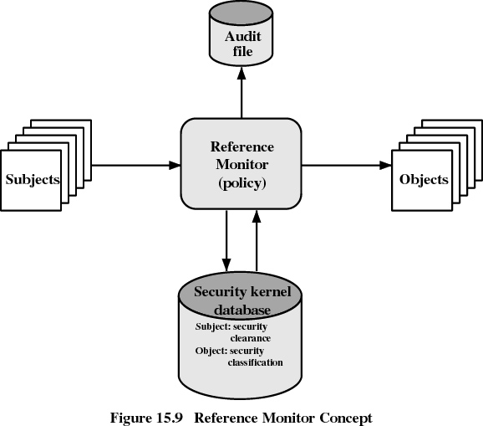

Slide 40
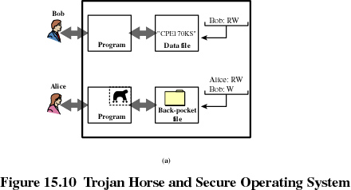
Trojan Horse Defense

Slide 41
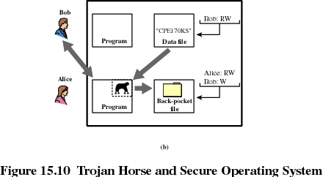
Trojan Horse Defense

Slide 42
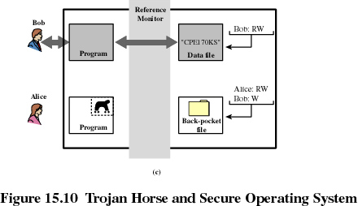
Trojan Horse Defense

Slide 43
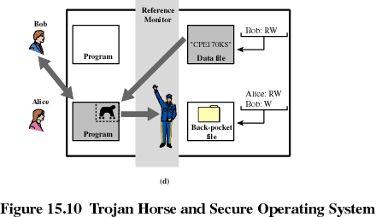
Trojan Horse Defense

